Slide 1
Data
Ying shen
Sse, tongji university
Sep. 2016

Slide 2
Data
A data set can often be viewed as a collection of data objects.
Other names for a data object include record, point, vector, pattern, event, case, sample, observation or entity.
 | sepal length | sepal width | petal length | petal width | class
Sample 1 | 5.1 | 3.5 | 1.4 | 0.2 | Iris-setosa
Sample 2 | 4.9 | 3.0 | 1.4 | 0.2 | Iris-setosa
Sample 3 | 7.0 | 3.2 | 4.7 | 1.4 | Iris-versicolor
Sample 4 | 6.4 | 3.2 | 4.5 | 1.5 | Iris-versicolo
…
Sample 149 | 6.3 | 3.3 | 6.0 | 2.5 | Iris-virginica
Sample 150 | 5.8 | 2.7 | 5.1 | 1.9 | Iris-virginica

Slide 3
Data
Data objects are described by a number of attributes that capture the basic characteristics of an object.
Other names for an attribute are variable, characteristic, field, feature, or dimension.
A data set is usually a file, in which
  The objects are records (or rows) in the file and
  Each field (or column) corresponds to an attribute.
 | sepal length | sepal width | petal length | petal width | class
Sample 1 | 5.1 | 3.5 | 1.4 | 0.2 | Iris-setosa
Sample 2 | 4.9 | 3.0 | 1.4 | 0.2 | Iris-setosa
Sample 3 | 7.0 | 3.2 | 4.7 | 1.4 | Iris-versicolor
Sample 4 | 6.4 | 3.2 | 4.5 | 1.5 | Iris-versicolo
…
Sample 149 | 6.3 | 3.3 | 6.0 | 2.5 | Iris-virginica
Sample 150 | 5.8 | 2.7 | 5.1 | 1.9 | Iris-virginica

Slide 4
Attributes
An attribute is a property or characteristic of an object that may vary, either from one object to another or from one time to another.
 | sepal length | sepal width | petal length | petal width | class
Sample 1 | 5.1 | 3.5 | 1.4 | 0.2 | Iris-setosa
Sample 2 | 4.9 | 3.0 | 1.4 | 0.2 | Iris-setosa
Sample 3 | 7.0 | 3.2 | 4.7 | 1.4 | Iris-versicolor
Sample 4 | 6.4 | 3.2 | 4.5 | 1.5 | Iris-versicolo
…
Sample 149 | 6.3 | 3.3 | 6.0 | 2.5 | Iris-virginica
Sample 150 | 5.8 | 2.7 | 5.1 | 1.9 | Iris-virginica

Slide 5
Different types of attributes
We can define four types of attributes
  Nominal
  Ordinal
  Interval
  Ratio
Nominal and ordinal attributes are collectively referred to as categorical or qualitative attributes.
Interval and ratio attributes are collectively referred to as quantitative or numeric attributes.

Slide 6
Different types of attributes
Nominal
  The values of a nominal attribute are just different names.
  They provide only enough information to distinguish one object from another.
  Examples: eye color, gender.
Ordinal
  The values of an ordinal attribute provide enough information to order objects.
  Example: grades.

Slide 7
Different types of attributes
Interval
  For interval attributes, the differences between values are meaningful.
  Example: calendar dates.
Ratio
  For ratio variables, both differences and ratios are meaningful.
  Example: monetary quantities, mass, length.

Slide 8
Different types of attributes
Another way to distinguish between attributes is by the number of values they can take.
Based on this criterion, attributes can be classified as either discrete or continuous.

Slide 9
Different types of attributes
Discrete
  A discrete attribute has a finite or countably infinite set of values.
  Such attributes can be categorical, such as gender, or numeric, such as counts.
  Discrete attributes are often represented using integer variables.
  Binary attributes are a special case of discrete attributes and assume only two values, e.g. true/false, yes/no, male/female, or 0/1.

Slide 10
Different types of attributes
Continuous
  A continuous attribute is one whose values are real numbers
  Examples include temperature, height or weight.
  Continuous attributes are typically represented as floating point variables.

Slide 11
Types of data sets
We consider the following different types of data sets
  Record data
  Transaction or market basket data
  Data matrix
  Sparse data matrix

Slide 12
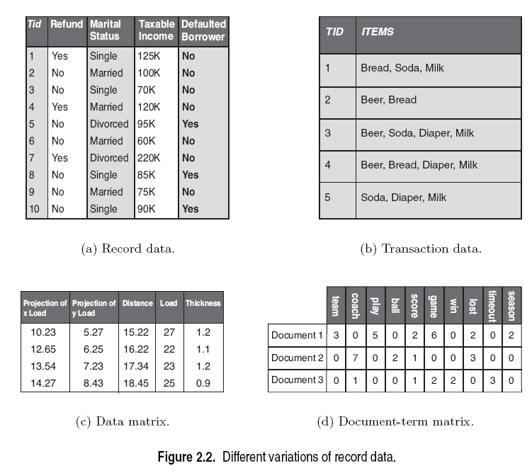
Types of data sets

Slide 13
Record data
Each record consists of a fixed set of data fields (attributes).
Record data is usually stored either in flat files or in relational databases.

Slide 14
Transaction or market basket data
Transaction data is a special type of record data.
Each transaction involves a set of items.
Example: the set of products purchased by a customer during one shopping trip constitutes a transaction.

Slide 15
Data matrix
If the data objects all have the same fixed set of numeric attributes, then they can be thought of as points (vectors) in a multi-dimensional space.
This kind of data set can be interpreted as an m by n matrix where
  There are m rows, one for each object.
  There are n columns, one for each attribute.
Standard matrix operations can be applied to transform and manipulate the data.

Slide 16
Sparse data matrix
A sparse data matrix is a special case of a data matrix in which there are a large number of zeros in the matrix, and only the non-zero attribute values are important.
Sparsity is an advantage because usually only the non-zero values need to be stored and manipulated.
This results in significant savings with respect to computation time and storage.

Slide 17
Sparse data matrix
An example is document data.
A document can be represented as a term vector, where
  Each term is a component (attribute) of the vector and
  The value of each component is the number of times the corresponding term occurs in the document.
This representation of a collection of documents is often called a document-term matrix.

Slide 18
Data quality
Precision
  The closeness of repeated measurements (of the same quantity) to one another.
  This is often measured by the standard deviation of a set of values.
Bias
  A systematic variation of measurements from the quantity being measured.
  This is measured by taking the difference between
    the mean of the set of values and
    the known value of the quantity being measured.

Slide 19
Data quality
Suppose we have a standard laboratory weight with a mass of 1g.
We want to assess the precision and bias of our new laboratory scale.
We weigh the mass five times, and obtain the values: {1.015, 0.990, 1.013, 1.001, 0.986}.
The mean of these values is 1.001.
The bias is thus 0.001.
The precision, as measured by the standard deviation, is 0.012.

Slide 20
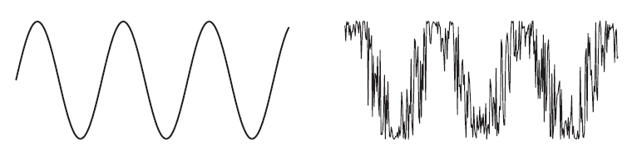
Data quality: Noise and outliers
Noise
  Noise is the random component of a measurement error.
Outliers
  Data objects that, in some sense, have characteristics that are different from most of the other data objects in the data set.
  Values of an attribute that are unusual with respect to the typical values for that attribute.

Slide 21
Data quality: Missing values
It is not unusual for an object to be missing one or more attribute values.
There are several strategies for dealing with missing data
  Eliminate data objects
  Estimate missing values

Slide 22
Data quality: Missing values
Eliminate data objects
  If a data set has only a few objects that have missing attribute values, then it may be convenient to omit them.
  However, even a partially specified data object contains some information.
  If many objects have missing values, then a reliable analysis can be difficult or impossible.

Slide 23
Data quality: Missing values
Estimate missing values
  A missing attribute value of a point can be estimated by the attribute values of the other points.
  If the attribute is discrete, then the most commonly occurring attribute value can be used.
  If the attribute is continuous, then the average attribute value of the other points is used.

Slide 24
Data preprocessing
There are a number of techniques for performing data preprocessing
  Aggregation
  Sampling
  Dimensionality reduction
  Feature subset selection
  Discretization and binarization
  Variable transformation

Slide 25
Aggregation
Aggregation is the combining of two or more objects into a single object.
There are several motivations for aggregation
  The smaller data sets resulting from aggregation require less memory and processing time.
  Aggregation can also provide a high-level view of the data.
  Aggregate quantities, such as averages or totals, have less variability than the individual objects.
A disadvantage of aggregation is the potential loss of interesting details.

Slide 26
Sampling
Sampling is the selection of a subset of the data objects to be analyzed.
Sometimes, it is too expensive or time consuming to process all the data.
Using a sampling algorithm can reduce the data size to a point where a better, but more computationally expensive algorithm can be used.
A sample is representative if it has approximately the same property (of interest) as the original set of data.

Slide 27
Sampling
The simplest type of sampling is simple random sampling.
For this type of sampling, there is an equal probability of selecting any particular item.
There are two variations on random sampling
  Sampling without replacement
  Sampling with replacement

Slide 28
Sampling
Sampling without replacement
  As each item is selected, it is removed from the set of all objects.
Sampling with replacement
  Objects are not removed from the data set as they are selected for the sample.
  The same object can be picked more than once.

Slide 29
Sampling
Once a sampling technique has been selected, it is still necessary to choose the sample size.
For larger sample sizes
  The probability that a sample will be representative will be increased.
  However, much of the advantage of sampling will also be eliminated.
For smaller sample sizes
  There may be a loss of important information.

Slide 30
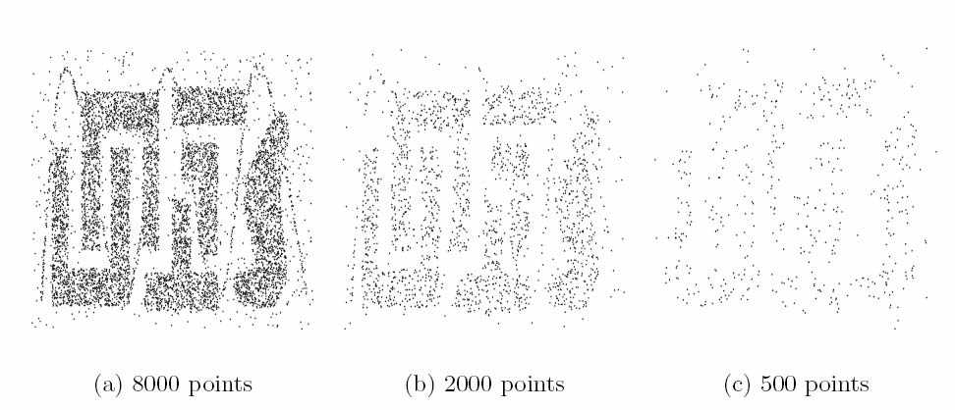
Sampling

Slide 31
Dimensionality reduction
The dimensionality of a data set is the number of attributes that each object possesses.
It is usually more difficult to analyze high-dimensional data (curse of dimensionality).
An important preprocessing step is dimensionality reduction.

Slide 32
Dimensionality reduction
There are a number of benefits to dimensionality reduction
  It can eliminate irrelevant features and reduce noise.
  It can lead to a more understandable model which involve fewer attributes.
  It may allow the data to be more easily visualized.
  The amount of time and memory required for processing the data is reduced.

Slide 33
Dimensionality reduction
The curse of dimensionality refers to the phenomenon that many types of data analysis become significantly harder as the dimensionality increases.
As dimensionality increases, the data becomes increasingly sparse in the space that it occupies.
There may not be enough data objects to allow the reliable creation of a model that describes the set of objects.

Slide 34
Dimensionality reduction
There are a number of techniques for dimensionality reduction
  Linear algebra techniques
  Feature subset selection

Slide 35
Linear algebra techniques
Techniques from linear algebra can be used to project data from a high-dimensional space to a low-dimensional space.
Principal Component Analysis (PCA) is a technique that finds new attributes that are
  linear combinations of the original attributes.
  capture the maximum amount of variation in the data.

Slide 36
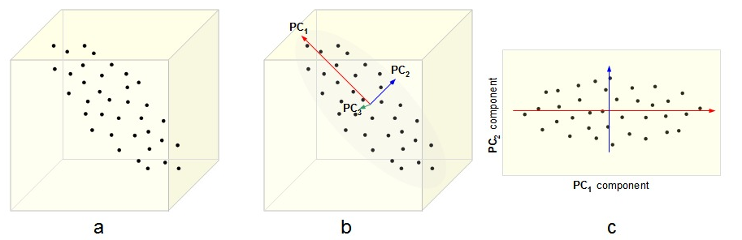
Principal component analysis

Slide 37
Feature subset selection
Another way to reduce the dimensionality is to use only a subset of the features.
This approach is effective if redundant and irrelevant features are present.
Redundant features duplicate much or all of the information contained in one or more other attributes.
Irrelevant features contain almost no useful information for the task at hand.

Slide 38
Feature subset selection
The ideal approach to feature selection is to
  Try all possible subsets of features.
  Take the subset that produces the best result.
Since the number of subsets involving n attributes is 2^{n}, such an approach is impractical in most situations.
There are three standard approaches to feature selection
  Embedded approaches
  Filter approaches
  Wrapper approaches

Slide 39
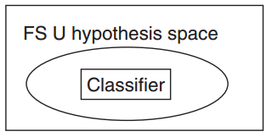
Embedded approaches
Feature selection occurs naturally as part of the algorithm.
The algorithm itself decides which attributes to use and which to ignore.
Example:
  Decision trees
  Weighted naive Bayes

Slide 40
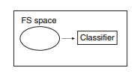
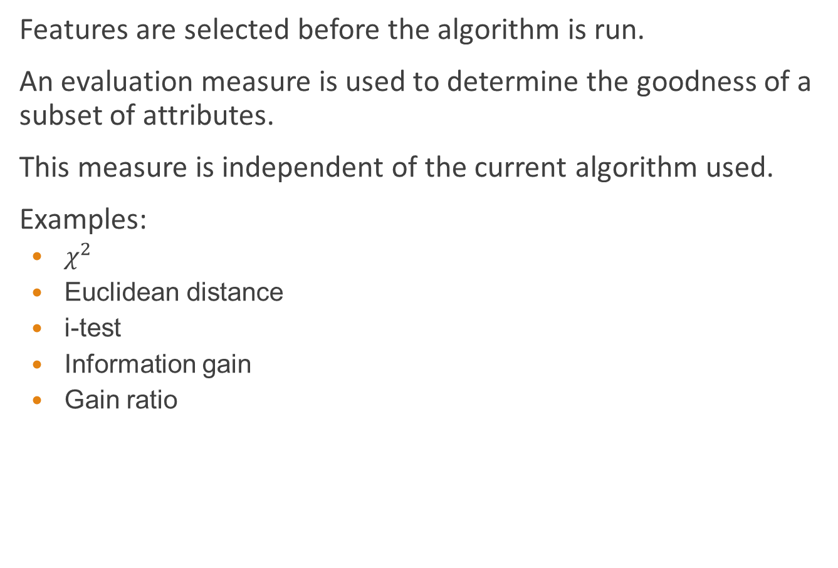
Filter approaches
Features are selected before the algorithm is run.
An evaluation measure is used to determine the goodness of a subset of attributes.
This measure is independent of the current algorithm used.
Examples:
  $χ^{2}$
  Euclidean distance
  i-test
  Information gain
  Gain ratio

Slide 41
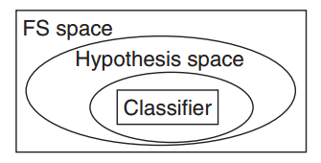
Wrapper approaches
These methods use the target algorithm as a black box to find the best subset of attributes.
Typically, not all the possible subsets are enumerated.

Slide 42
Discretization and binarization
Some algorithms require that the data be in the form of categorical attributes.
It is often necessary to transform a continuous attribute into a categorical attribute (discretization).
Both continuous and discrete attributes may need to be transformed into one or more binary attributes (binarization).

Slide 43
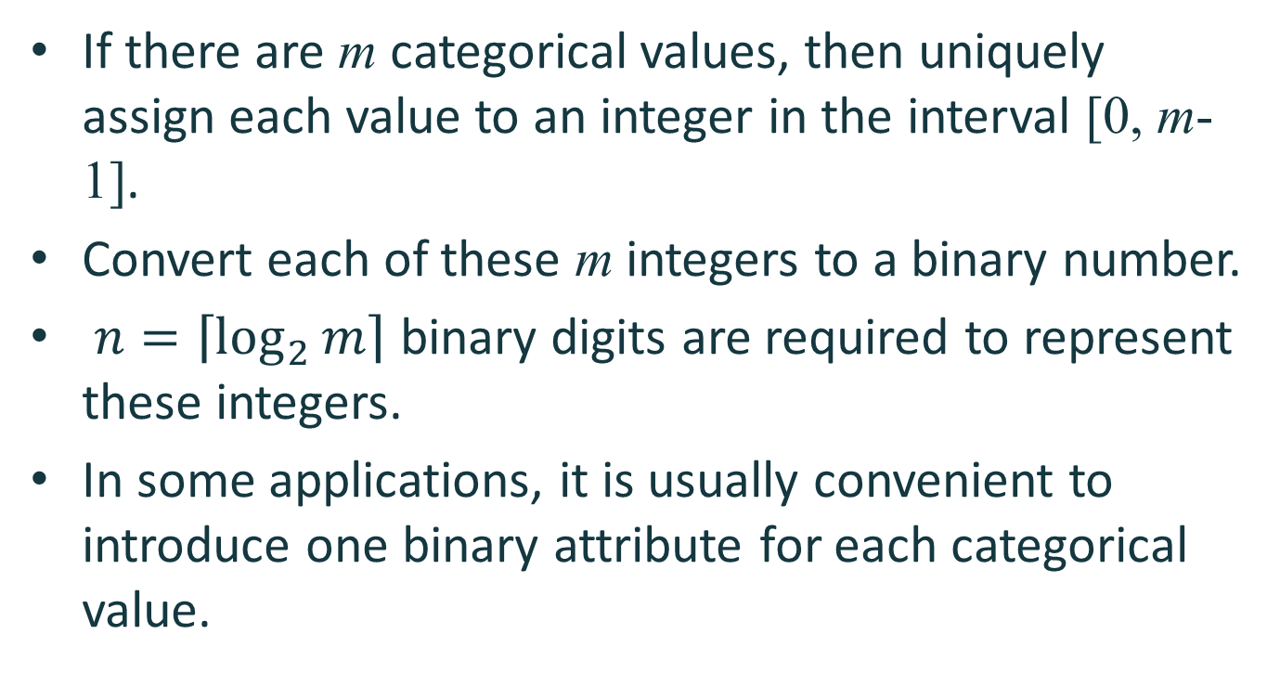
Binarization
If there are m categorical values, then uniquely assign each value to an integer in the interval [0, m-1].
Convert each of these m integers to a binary number.
$n=\left\lceil \log_{2}{m}\right\rceil$ binary digits are required to represent these integers.
In some applications, it is usually convenient to introduce one binary attribute for each categorical value.

Slide 44
Binarization
Categorical Value | Integer Value | x₁ | x₂ | x₃
awful | 0 | 0 | 0 | 0
poor | 1 | 0 | 0 | 1
OK | 2 | 0 | 1 | 0
good | 3 | 0 | 1 | 1
great | 4 | 1 | 0 | 0

Slide 45
Binarization
Categorical Value | Integer Value | x₁ | x₂ | x₃ | x₄ | x₅
awful | 0 | 1 | 0 | 0 | 0 | 0
poor | 1 | 0 | 1 | 0 | 0 | 0
OK | 2 | 0 | 0 | 1 | 0 | 0
good | 3 | 0 | 0 | 0 | 1 | 0
great | 4 | 0 | 0 | 0 | 0 | 1

Slide 46
Discretization
Transformation of a continuous attribute to a categorical attribute involves two subtasks
  Deciding how many categories to have
  Determining how to map the values of the continuous attribute to these categories.

Slide 47
Discretization
In the first step
  The values of the continuous attribute are first sorted.
  They are then divided into n intervals by specifying n-1 split points.
In the second step
  All the values in one interval are mapped to the same categorical value.

Slide 48
Discretization
The equal width approach divides the range of the attribute into a user-specified number of intervals, each having the same width.
The equal frequency approach tries to put the same number of objects into each interval.

Slide 49
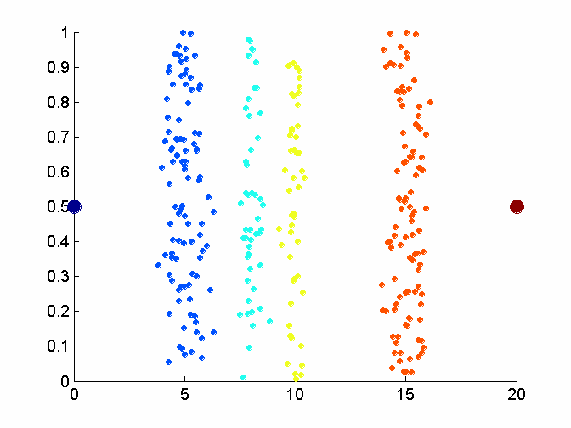
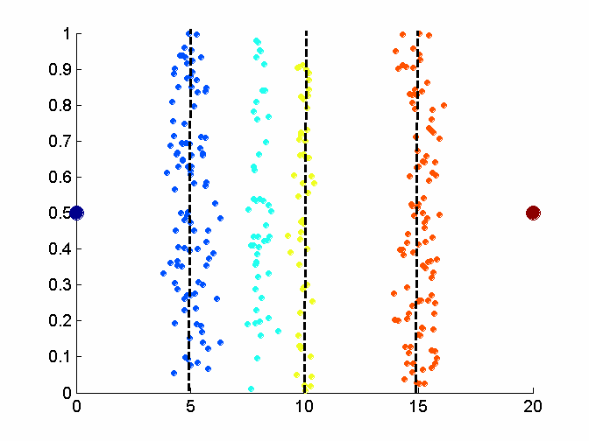
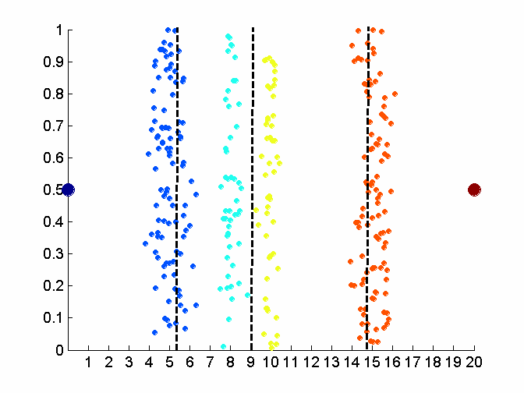
Discretization
Original data
Equal width discretization
Equal frequency discretization

Slide 50
Variable transformation
A variable transformation refers to a transformation that is applied to all the values of a variable.
There are two important types of variable transformations
  Simple functional transformation
  Normalization or standardization

Slide 51
Simple functions
For this type of variable transformation, a simple mathematical function is applied to each value individually.
If x is a variable, then examples of such transformations include x^{k}, log x, e^{x}, 1/x or |x|.

Slide 52
Normalization
The goal of normalization or standardization is to make an entire set of values have a particular property.
If different variables are to be combined in some way, normalization is necessary to avoid having a variable with large values dominate the results of the calculation.

Slide 53
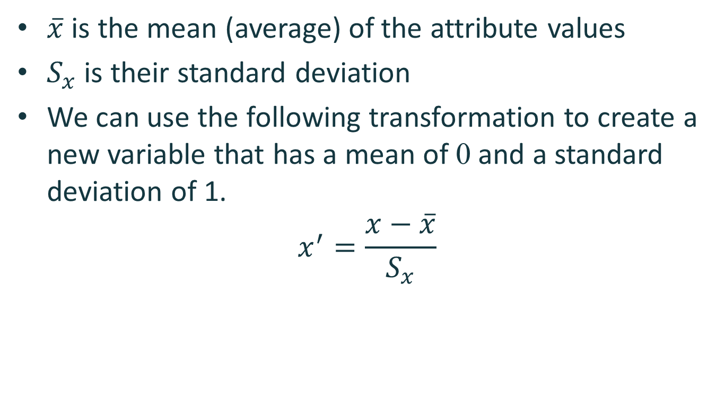
Normalization
$\overline{x}$ is the mean (average) of the attribute values
$S_{x}$ is their standard deviation
We can use the following transformation to create a new variable that has a mean of 0 and a standard deviation of 1.
$$x^{′}=\frac{x−\overline{x}}{S_{x}}$$

Slide 54
Similarity and dissimilarity
The similarity between two objects is a numerical measure of the degree to which the two objects are alike.
Similarities are higher for pairs of objects that are more alike.

Slide 55
Similarity and dissimilarity
The dissimilarity between two objects is a numerical measure of the degree to which the two objects are different.
Dissimilarities are lower for more similar pair of objects.
Frequently, the term distance is used as a synonym for dissimilarity.

Slide 56
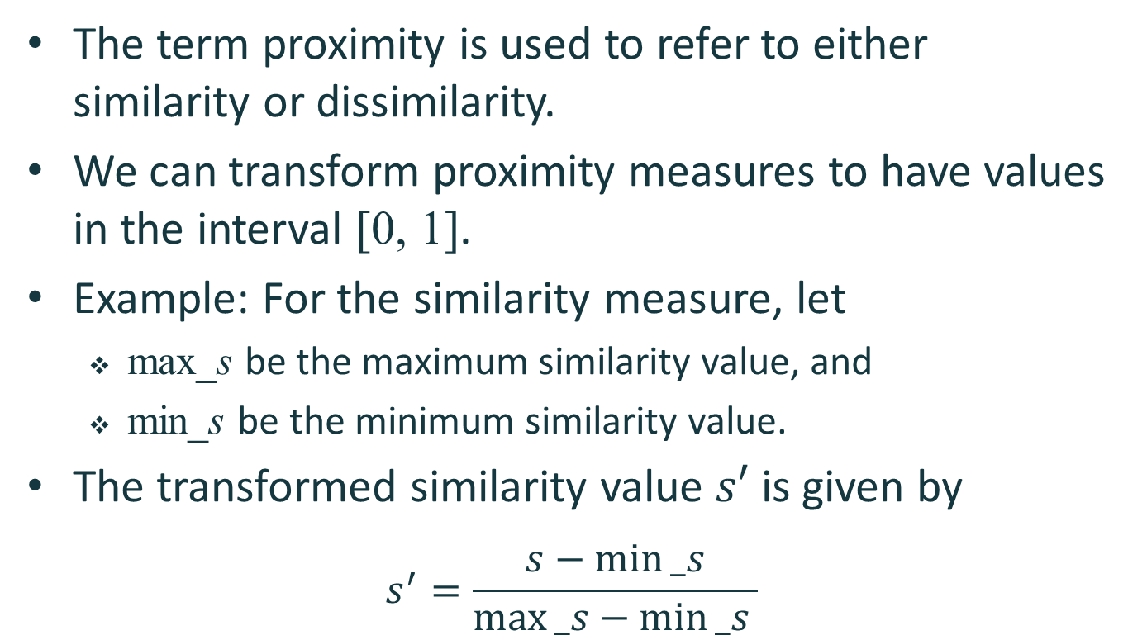
Similarity and dissimilarity
The term proximity is used to refer to either similarity or dissimilarity.
We can transform proximity measures to have values in the interval [0, 1].
Example: For the similarity measure, let
  max_s be the maximum similarity value, and
  min_s be the minimum similarity value.
The transformed similarity value $s′$ is given by
$$s^{′}=\frac{s−min⁡_s}{max⁡_s−min⁡_s }$$

Slide 57
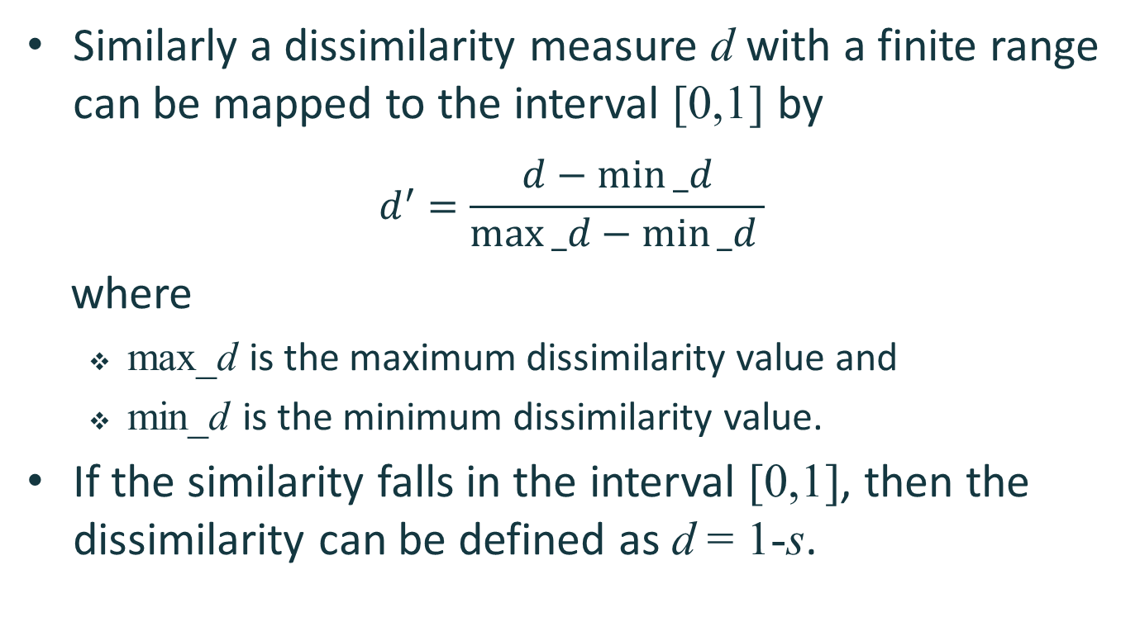
Similarity and dissimilarity
Similarly a dissimilarity measure d with a finite range can be mapped to the interval [0,1] by
$$d^{′}=\frac{d−min⁡_d}{max⁡_d−min⁡_d }$$
where
  max_d is the maximum dissimilarity value and
  min_d is the minimum dissimilarity value.
If the similarity falls in the interval [0,1], then the dissimilarity can be defined as d = 1-s.

Slide 58
Similarity and dissimilarity between simple attributes
The proximity of objects with a number of attributes is typically defined by combining the proximities of individual attributes.
We consider the definition of similarity/dissimilarity measures for the following attribute types
  Nominal
  Ordinal
  Interval/Ratio

Slide 59
Nominal
Nominal attributes only convey information about the distinctness of objects.
All we can say is that two objects either have the same value or they do not.
In this case, similarity is defined as
  1 if attribute values match
  0 otherwise.
A dissimilarity would be defined in the opposite way
  0 if the attribute values match
  1 otherwise

Slide 60
Ordinal
For ordinal attributes, information about order should be taken into account.
The values of the ordinal attribute are often mapped to successive integers.
The dissimilarity can be defined by taking the absolute difference between these integers.
The similarity for ordinal attributes can be defined by
  Transforming the dissimilarity into the interval [0,1].
  Applying the equation s = 1-d.

Slide 61
Interval/Ratio
For interval or ratio attributes, the natural measure of dissimilarity between two objects is the absolute difference of their values.
The dissimilarity value can be transformed to a similarity value by using the same technique as in the case of ordinal attributes.

Slide 62
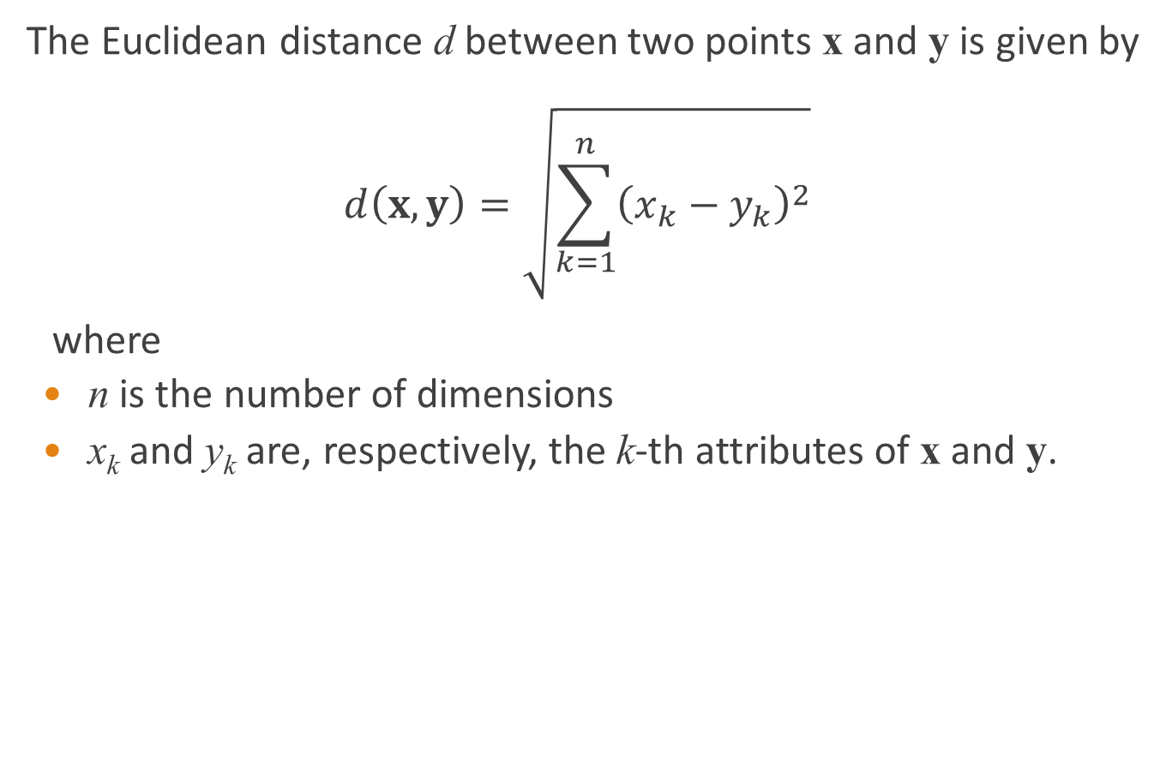
Distance
The Euclidean distance d between two points x and y is given by
$$d\left(x,y\right)=\sqrt{\sum_{k=1}^{n}{{\left(x_{k}−y_{k}\right)}^{2}}}$$
where
  n is the number of dimensions
  x_{k} and y_{k} are, respectively, the k-th attributes of x and y.

Slide 63

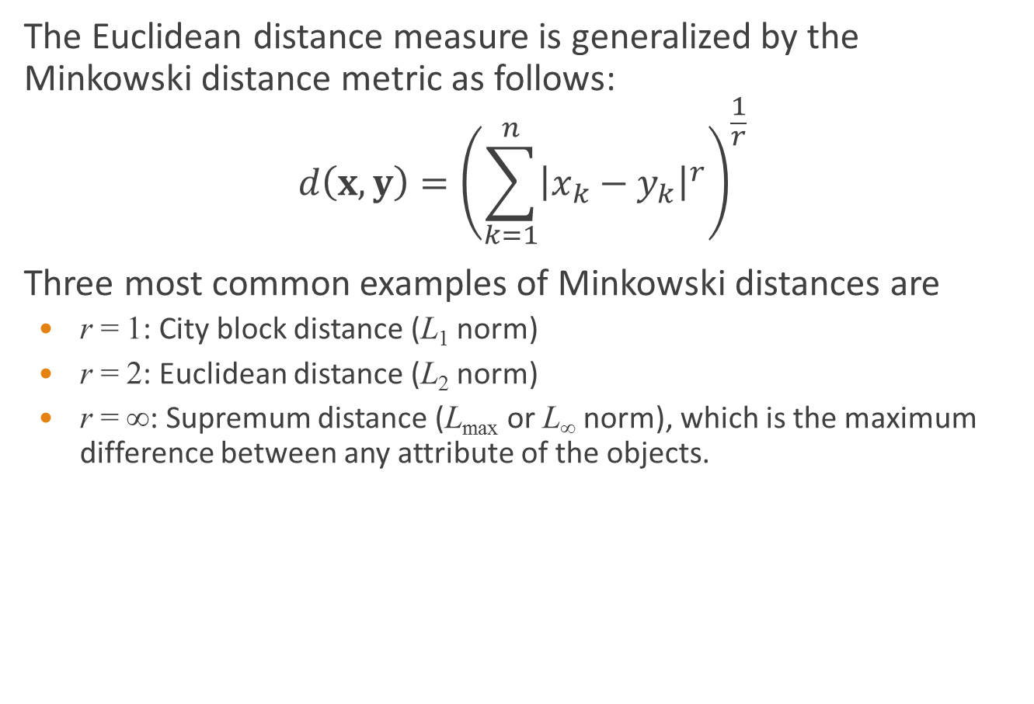
Distance
The Euclidean distance measure is generalized by the Minkowski distance metric as follows:
$$d\left(x,y\right)={\left(\sum_{k=1}^{n}{{\left|x_{k}−y_{k}\right|}^{r}}\right)}^{\frac{1}{r}}$$
Three most common examples of Minkowski distances are
  r = 1: City block distance (L₁ norm)
  r = 2: Euclidean distance (L₂ norm)
  r = ∞: Supremum distance (L_{max} or L∞ norm), which is the maximum difference between any attribute of the objects.

Slide 64
Distance
y
p1
p3
p4
p2
x

Slide 65
Distance
point | x | y
p1 | 0 | 2
p2 | 2 | 0
p3 | 3 | 1
p4 | 5 | 1
x and y coordinates of four points
 | p1 | p2 | p3 | p4
p1 | 0.0 | 2.8 | 3.2 | 5.1
p2 | 2.8 | 0.0 | 1.4 | 3.2
p3 | 3.2 | 1.4 | 0.0 | 2.0
p4 | 5.1 | 3.2 | 2.0 | 0.0
Euclidean distance matrix

Slide 66
Distance
point | x | y
p1 | 0 | 2
p2 | 2 | 0
p3 | 3 | 1
p4 | 5 | 1
x and y coordinates of four points
 | p1 | p2 | p3 | p4
p1 | 0.0 | 4.0 | 4.0 | 6.0
p2 | 4.0 | 0.0 | 2.0 | 4.0
p3 | 4.0 | 2.0 | 0.0 | 2.0
p4 | 6.0 | 4.0 | 2.0 | 0.0
 | p1 | p2 | p3 | p4
p1 | 0.0 | 2.0 | 3.0 | 5.0
p2 | 2.0 | 0.0 | 1.0 | 3.0
p3 | 3.0 | 1.0 | 0.0 | 2.0
p4 | 5.0 | 3.0 | 2.0 | 0.0
L₁ distance matrix
L∞ distance matrix

Slide 67
Distance
A distance measure has some well-known properties
  Positivity
    d(x, y) ≥ 0 for all x and y
    d(x, y) = 0 if and only if x = y
  Symmetry
    d(x, y) = d(y, x) for all x and y.
  Triangle inequality
    d(x, z) ≤ d(x, y) + d(y, z) for all points x, y and z.

Slide 68
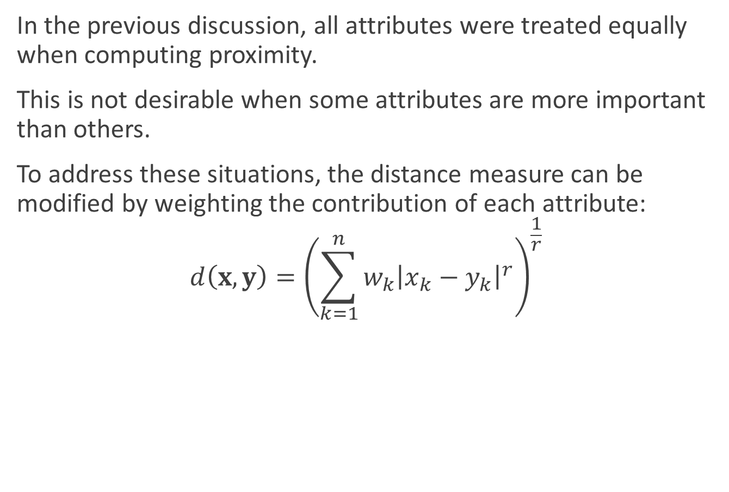
Distance
In the previous discussion, all attributes were treated equally when computing proximity.
This is not desirable when some attributes are more important than others.
To address these situations, the distance measure can be modified by weighting the contribution of each attribute:
$$d\left(x,y\right)={\left(\sum_{k=1}^{n}{{w_{k}\left|x_{k}−y_{k}\right|}^{r}}\right)}^{\frac{1}{r}}$$

Slide 69
Summary statistics
Summary statistics are quantities that capture various characteristics of a large set of values with a small set of numbers.
We consider the following summary statistics
  Frequencies and the mode
  Measure of location: mean and median
  Measure of spread: range and variance

Slide 70
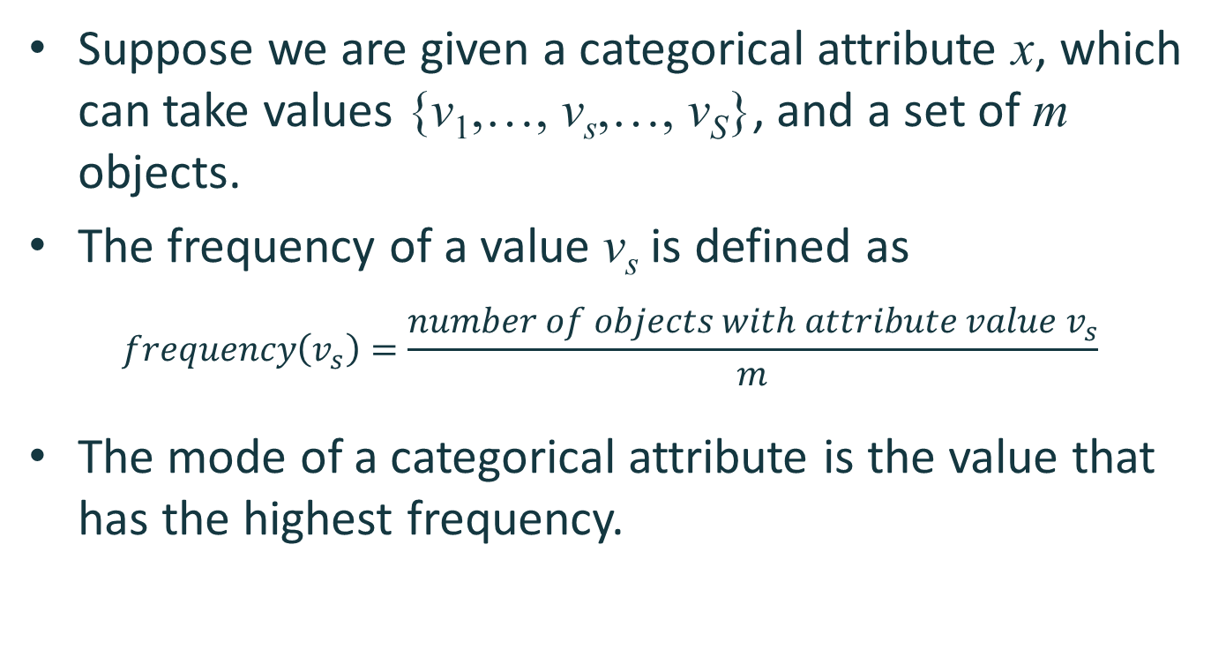
Frequencies and the mode
Suppose we are given a categorical attribute x, which can take values {v₁,…, v_{s},…, v_{S}}, and a set of m objects.
The frequency of a value v_{s} is defined as
$$frequency\left(v_{s}\right)=\frac{number of objects with attribute value v_{s}}{m}$$
The mode of a categorical attribute is the value that has the highest frequency.

Slide 71
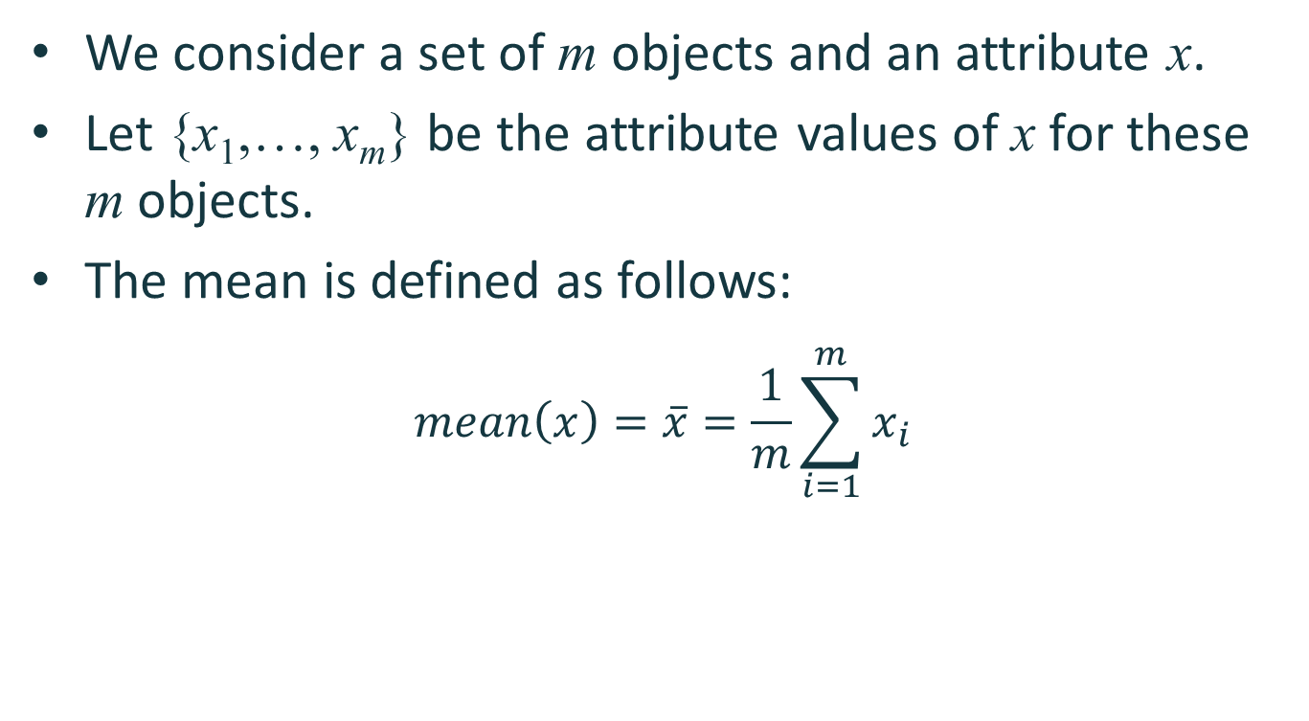
Mean
We consider a set of m objects and an attribute x.
Let {x₁,…, x_{m}} be the attribute values of x for these m objects.
The mean is defined as follows:
$$mean\left(x\right)=\overline{x}=\frac{1}{m}\sum_{i=1}^{m}{x_{i}}$$

Slide 72
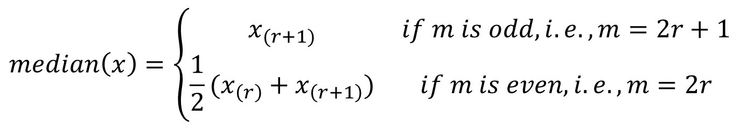
Median
Let {x₍₁₎,…, x_{(m)}} represent the values of x after they have been sorted in non-decreasing order.
Thus, x₍₁₎=min(x) and x_{(m)}=max(x).
The median is defined as follows:
$$median\left(x\right)=\left\{\begin{matrix}x_{(r+1)} & if m is odd, i.e., m=2r+1 \\ \frac{1}{2}(x_{\left(r\right)}+x_{\left(r+1\right)}) & if m is even, i.e., m=2r\end{matrix}\right.$$

Slide 73
Mean and median
The mean is sensitive to the presence of outliers.
The median provides a more robust estimate of the middle of a set of values.
To overcome problems with the mean, the notion of a trimmed mean is sometimes used.
  A percentage p between 0 and 100 is specified.
  The top and bottom (p/2)% of the data is thrown out.
  The mean is then calculated in the normal way.

Slide 74
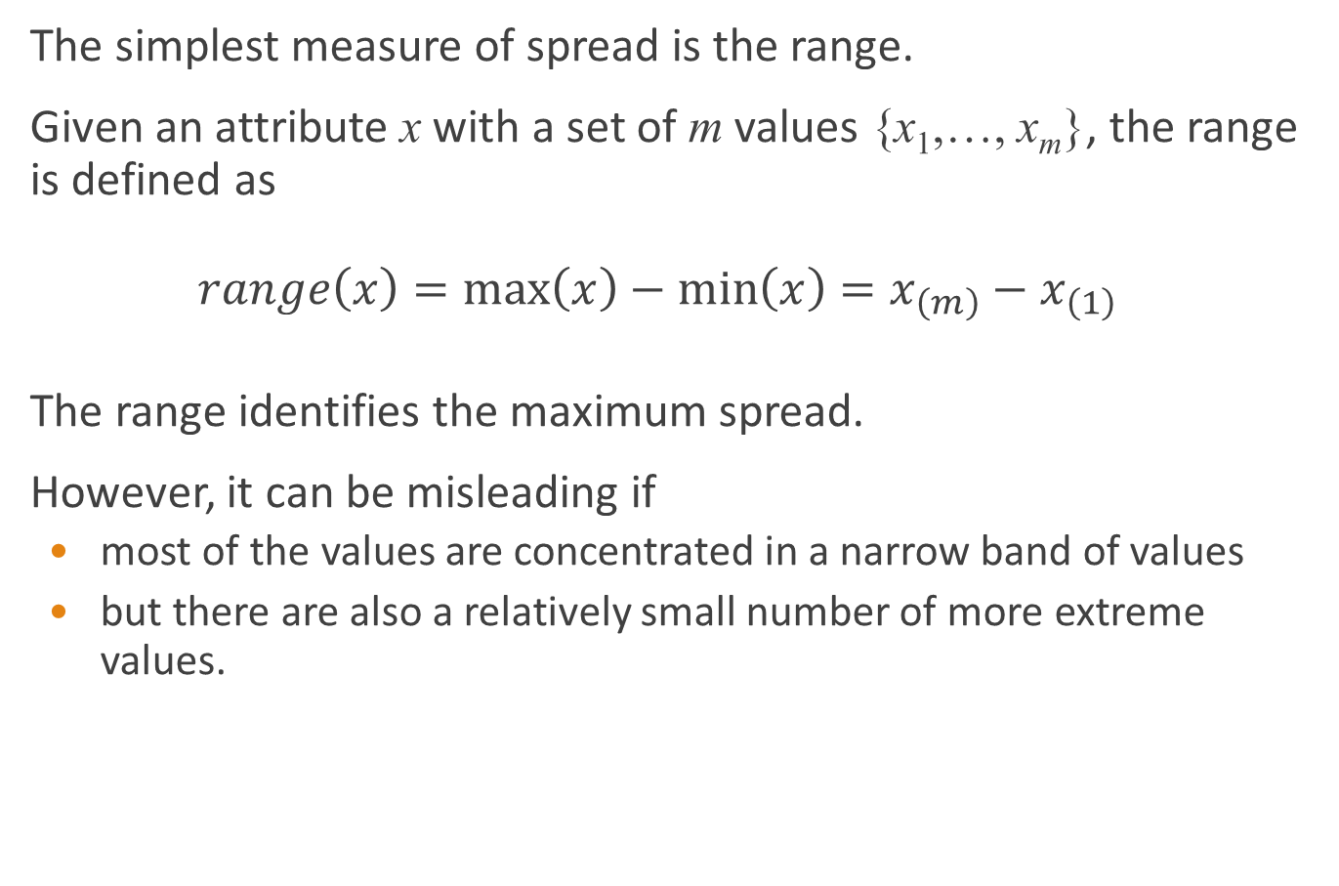
Range
The simplest measure of spread is the range.
Given an attribute x with a set of m values {x₁,…, x_{m}}, the range is defined as
$$range\left(x\right)=\max\left(x\right)−\min\left(x\right)=x_{\left(m\right)}−x_{\left(1\right)}$$
The range identifies the maximum spread.
However, it can be misleading if
  most of the values are concentrated in a narrow band of values
  but there are also a relatively small number of more extreme values.

Slide 75
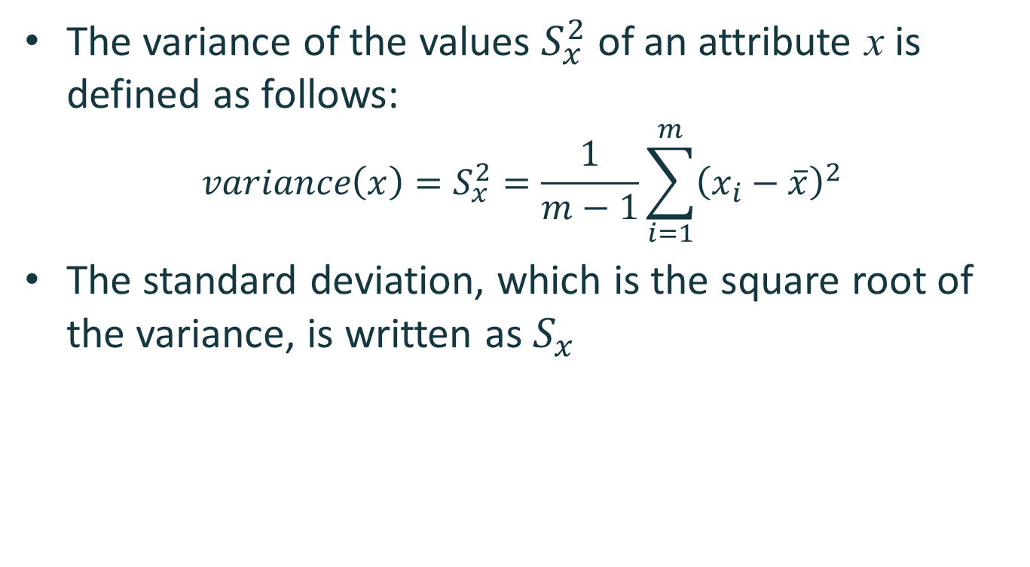
Variance
The variance of the values $S_{x}^{2}$ of an attribute x is defined as follows:
$$variance\left(x\right)=S_{x}^{2}=\frac{1}{m−1}\sum_{i=1}^{m}{{\left(x_{i}−\overline{x}\right)}^{2}}$$
The standard deviation, which is the square root of the variance, is written as $S_{x}$

Slide 76
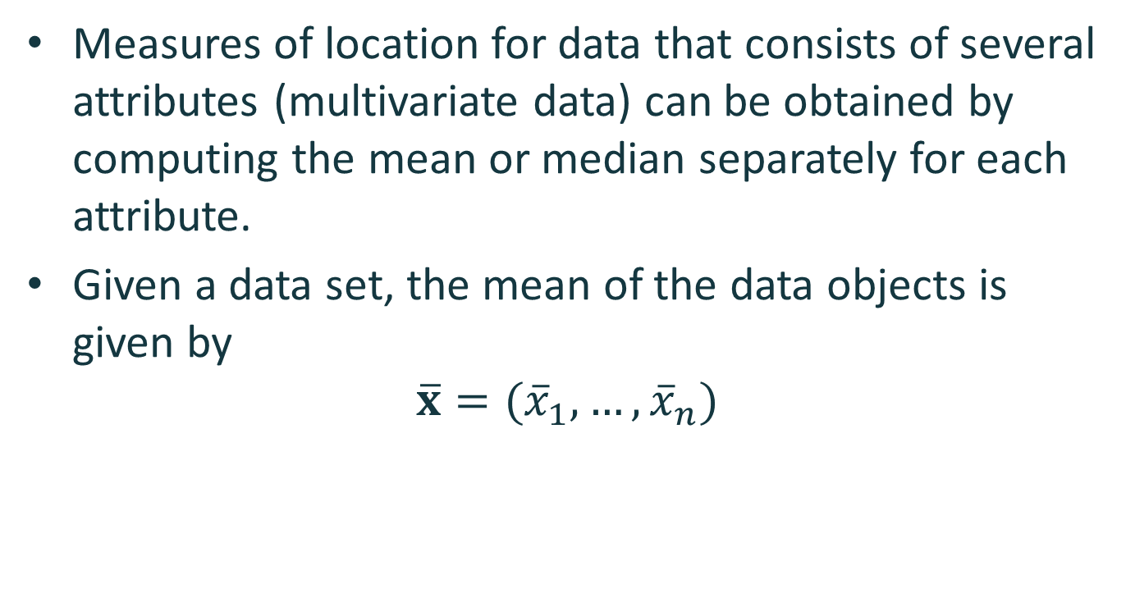
Multivariate summary statistics
Measures of location for data that consists of several attributes (multivariate data) can be obtained by computing the mean or median separately for each attribute.
Given a data set, the mean of the data objects is given by
$$\overline{x}=({\overline{x}}_{1},…, {\overline{x}}_{n})$$

Slide 77
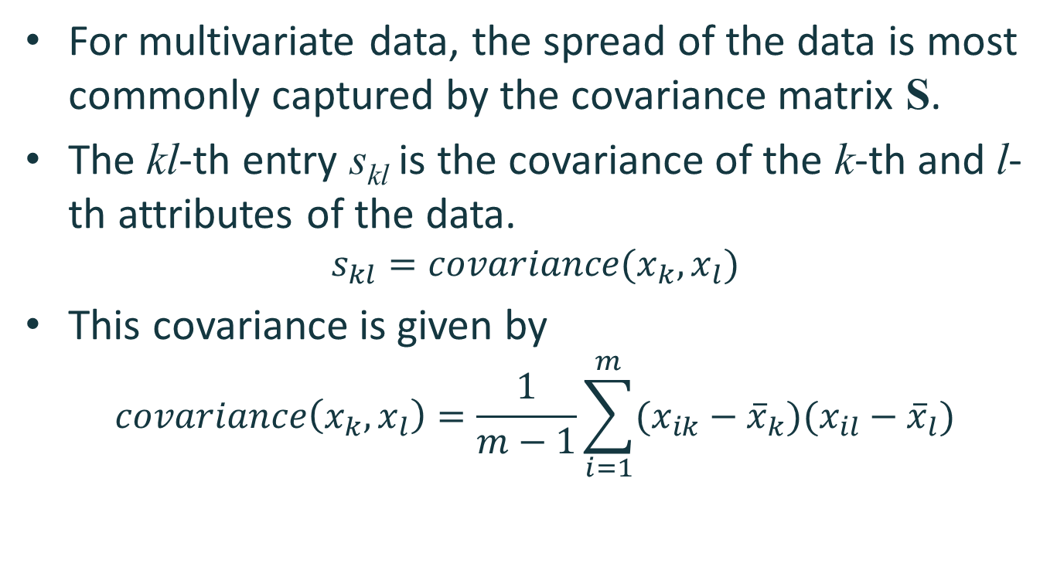
Multivariate summary statistics
For multivariate data, the spread of the data is most commonly captured by the covariance matrix S.
The kl-th entry s_{kl} is the covariance of the k-th and l-th attributes of the data.
$$s_{kl}=covariance(x_{k},x_{l})$$
This covariance is given by
$$covariance\left(x_{k},x_{l}\right)=\frac{1}{m−1}\sum_{i=1}^{m}{(x_{ik}−{\overline{x}}_{k})(x_{il}−{\overline{x}}_{l})}$$

Slide 78
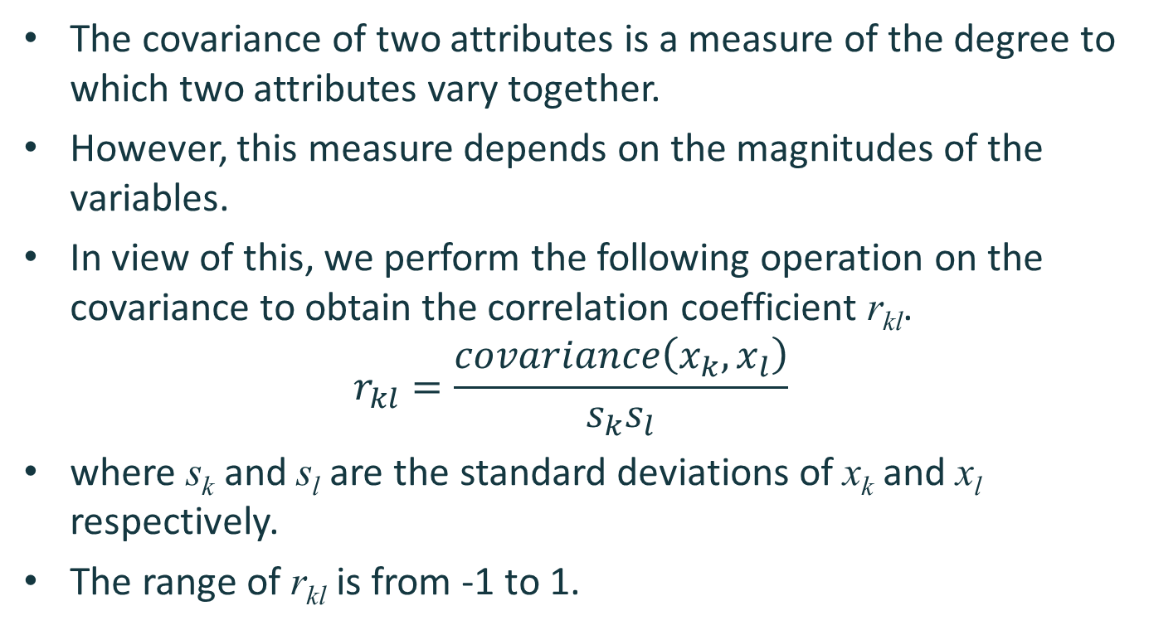
Multivariate summary statistics
The covariance of two attributes is a measure of the degree to which two attributes vary together.
However, this measure depends on the magnitudes of the variables.
In view of this, we perform the following operation on the covariance to obtain the correlation coefficient r_{kl}.
$$r_{kl}=\frac{covariance\left(x_{k},x_{l}\right)}{s_{k}s_{l}}$$
where s_{k} and s_{l} are the standard deviations of x_{k} and x_{l} respectively.
The range of r_{kl} is from -1 to 1.

Slide 79
Data visualization
Data visualization is the display of information in a graphic or tabular format.
The motivation for using visualization is that people can quickly absorb large amounts of visual information and find patterns in it.
We consider the following data visualization techniques
  Histogram
  Scatter plot

Slide 80
Histogram
A histogram is a plot that displays the distribution of values for attributes by
  dividing the possible values into bins and
  showing the number of objects that fall into each bin.
Each bin is represented by one bar.
The area of each bar is proportional to the number of values that fall into the corresponding range.

Slide 81
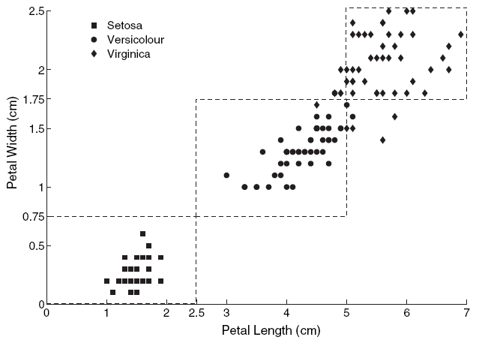
Histogram
Iris data set from UCI Machine Learning Repository:
Species
  Setosa (50)
  Versicolour (50)
  Virginica (50)
Attributes
  Sepal length
  Sepal width
  Petal length
  Petal width

Slide 82



Histogram
petal
sepal
Iris Setosa
Iris Versicolor
Iris Virginica

Slide 83
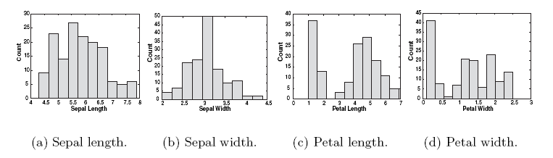
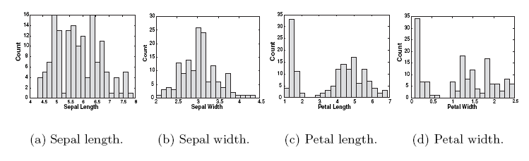
Histogram
Histograms of four Iris attributes (10 bins)
Histograms of four Iris attributes (20 bins)

Slide 84
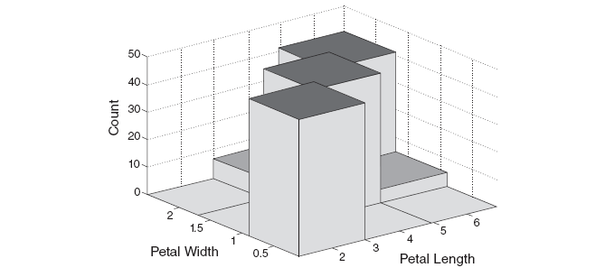
Histogram
In a two-dimensional histogram
  Each attribute is divided into intervals.
  The two sets of intervals define two-dimensional rectangles of values.

Slide 85
Scatter plot
A scatter plot can graphically show the relationship between two attributes.
In particular, it can be used to judge the degree of linear correlation of a data set.

Slide 86
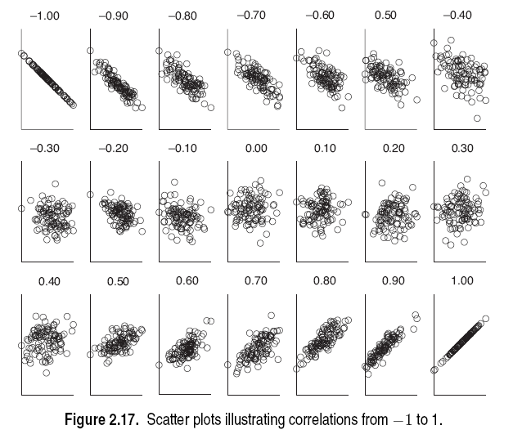
Scatter plot

